Slide 1
Computers Are Cool!
Computer Hardware and Software Overview from a Computer Architect
Mr. Jeremy.

Slide 2
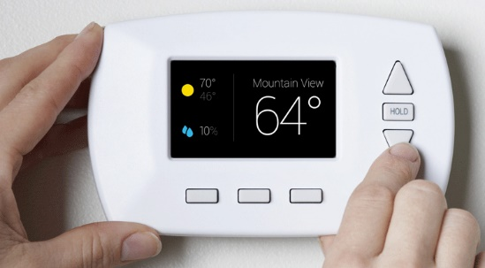
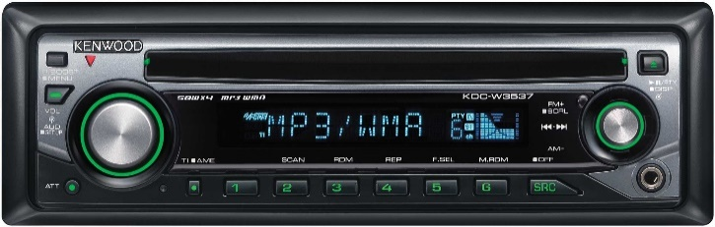
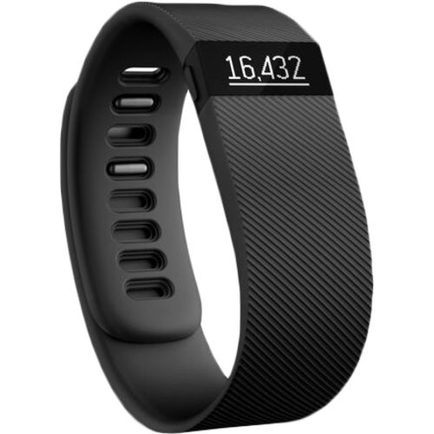
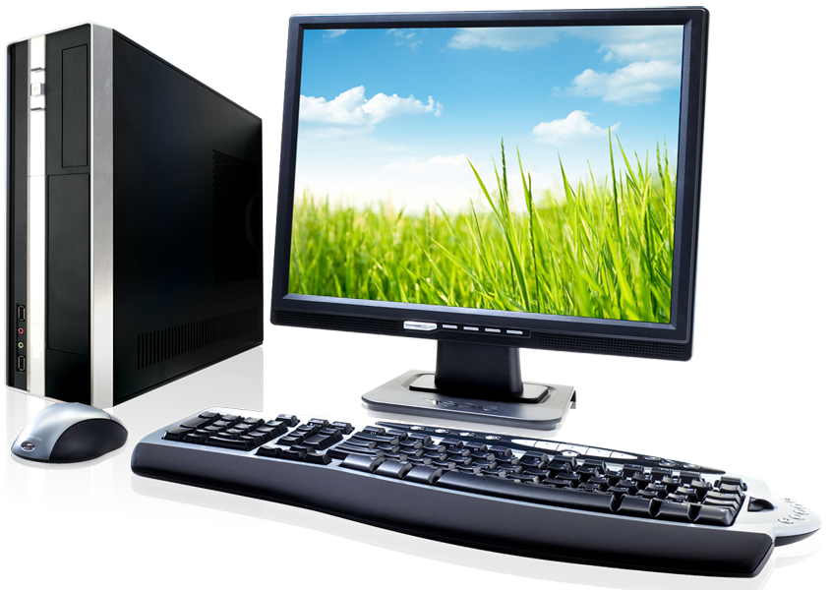
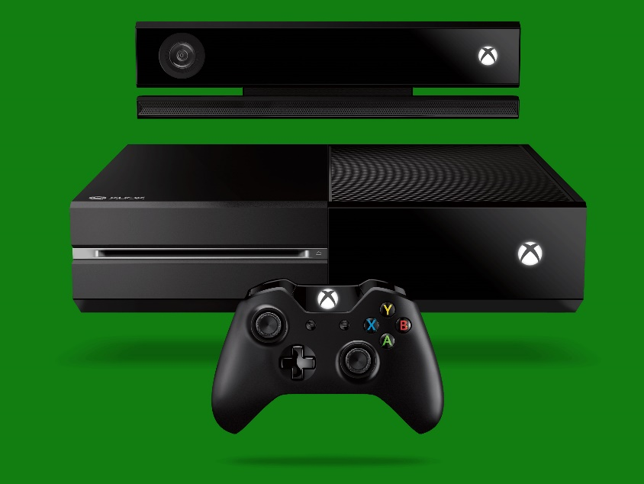
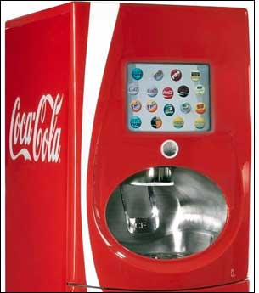
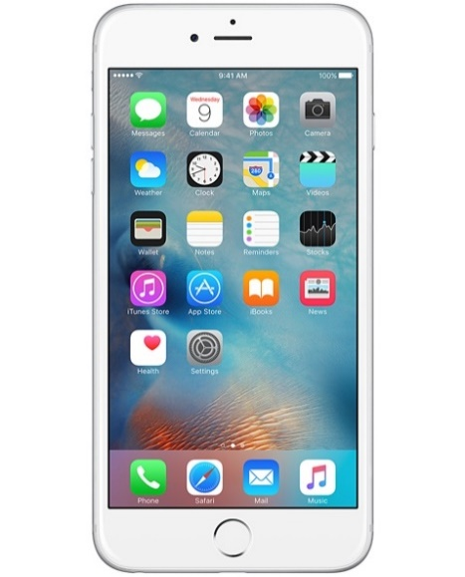
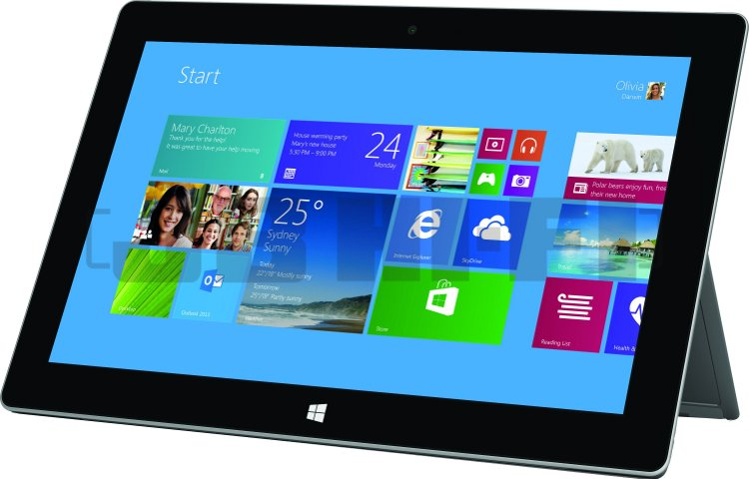
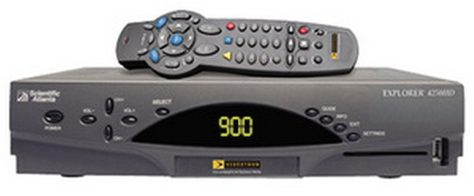
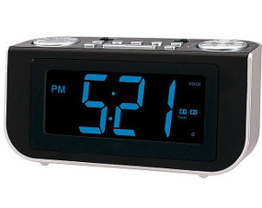
What do all of these things have in common?

Slide 3
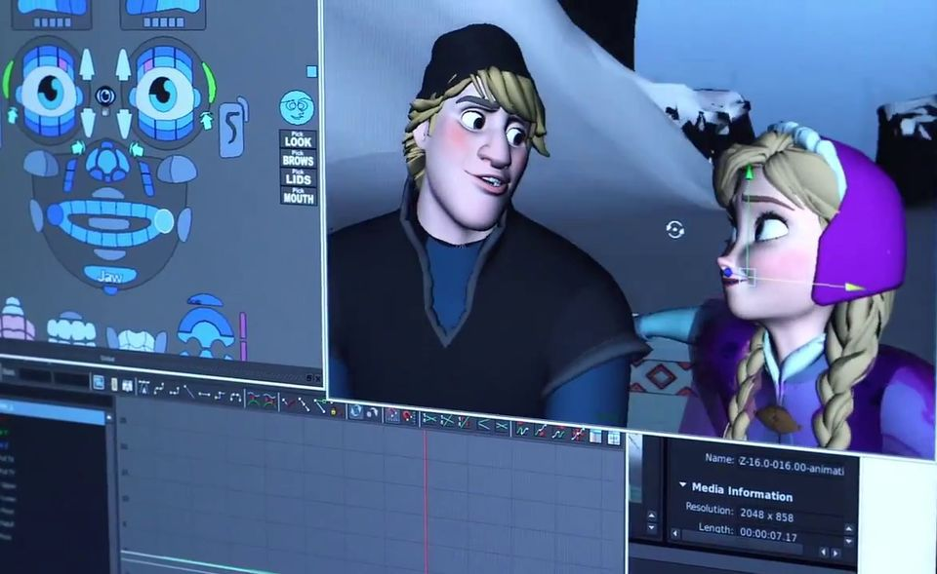
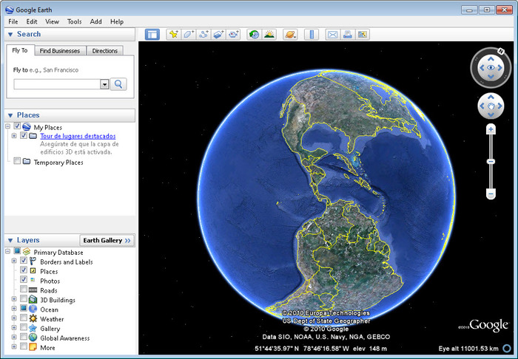
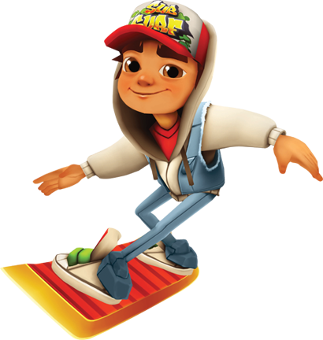
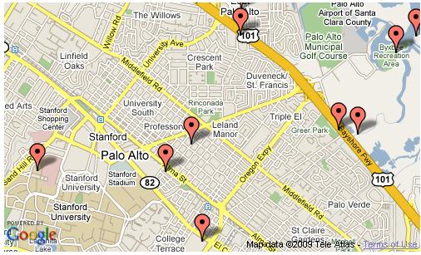
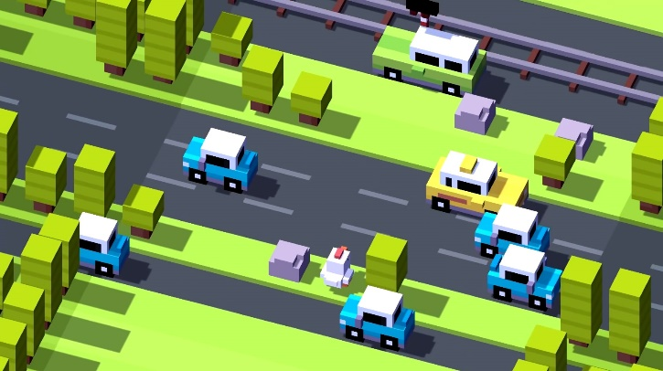
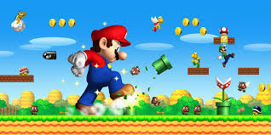
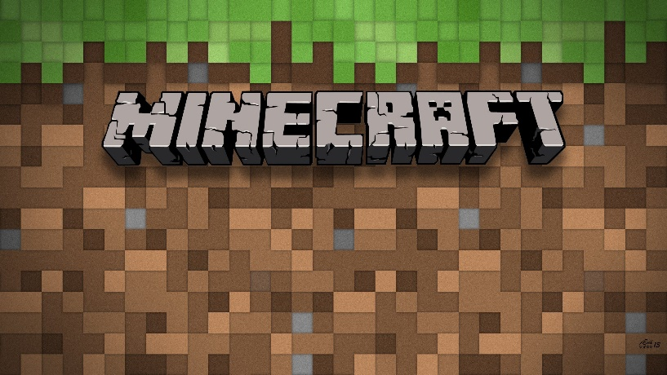
Computers can be programmed (told) to do cool things

Slide 4
Computers are not magical: They just do what you tell them to do!
But they speak a different language, you have to tell them what to do in computer language.
void Main()
{
Console.WriteLine("Please type your name and press Enter.");
var name = Console.ReadLine();
if (string.IsNullOrWhiteSpace(name))
{
Console.WriteLine("You didn't enter a name.");
return;
}
Console.WriteLine("Hey {0}!", name);
}

Slide 5
Demo

Slide 6
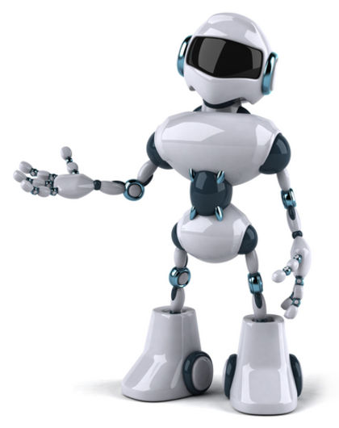

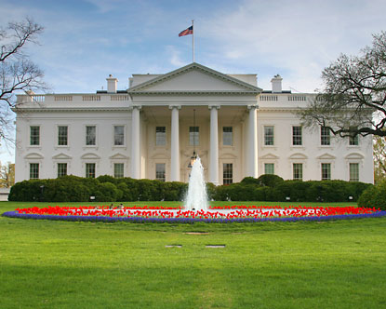

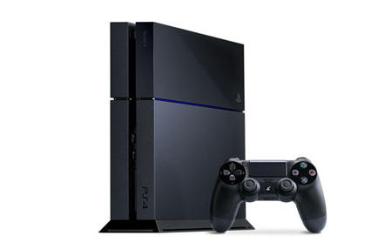

Where do Computer Programmers work?

Slide 7
You Must Love to Learn and Have These Character Traits
Learn
Math
Science
Reading and Writing
Character Traits
Responsibility
Team Work
Creativity

Slide 8

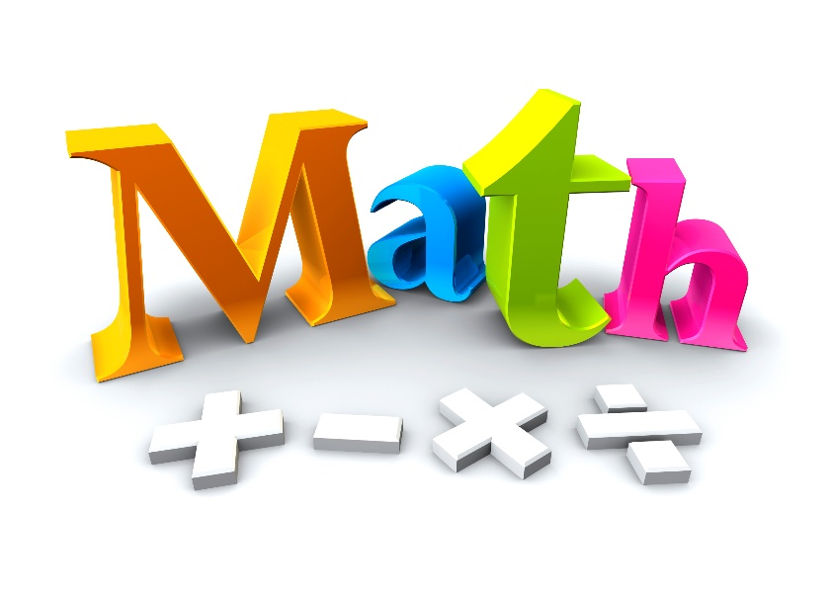
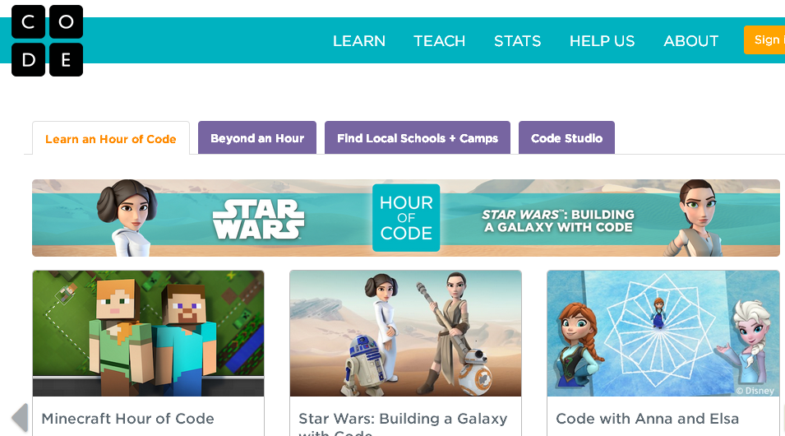
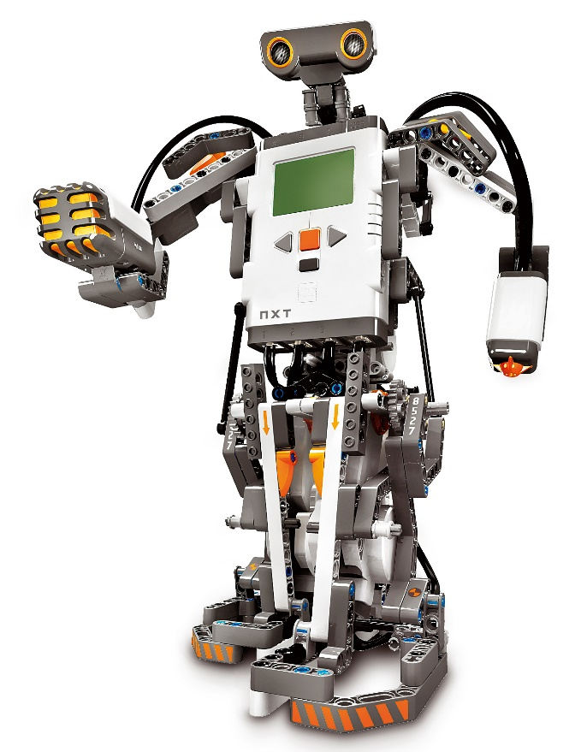
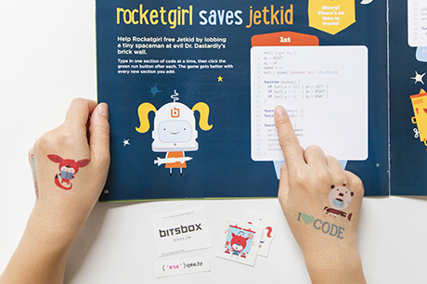
How can I Become a Computer Programmer? (and when can I start?)

Slide 9
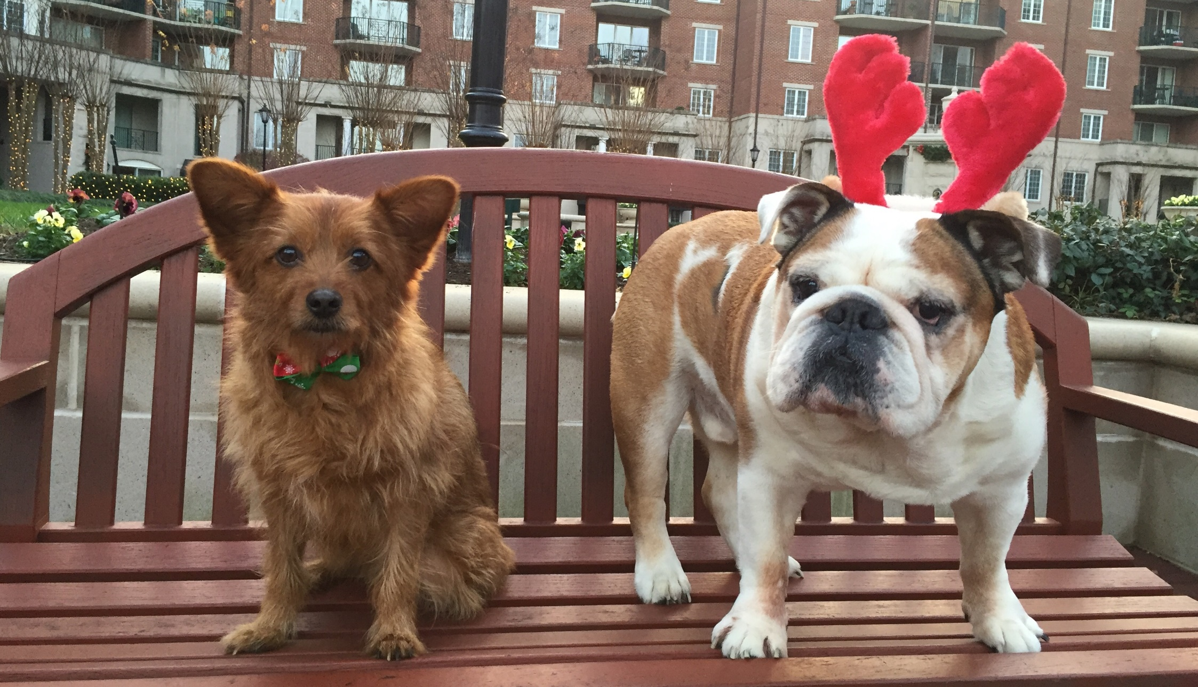
Questions?

